Slide 1
Clean Energy SHoes
-WIZENGAMOT
-SREEKUMAR, PAULU, PAUL, ASWIN, RONAL
-Prepared by RONAL

Slide 2
Problem
Growing Demand: Global demand for renewable energy solutions is rising due to sustainability concerns and energy efficiency needs.
Battery Storage: Effective storage solutions are needed to store the converted electrical energy in batteries for various applications, ensuring reliability and efficiency.
Shoe-Based Energy Harvesting Opportunity: There's a ripe opportunity to develop shoe-based energy harvesting systems, tapping into the piezoelectric effect to convert footfalls into electrical energy.

Slide 3
Problem
Efficient Conversion: Key challenge lies in designing efficient mechanisms to convert mechanical energy from footfalls into electrical energy within the shoe structure.
Sustainability Focus: This initiative addresses the pressing need for clean energy solutions by utilizing everyday movement, reducing reliance on conventional energy sources.
Contribution to Green Future: By enabling power generation through human movement, the project contributes to a greener future and environmental conservation efforts.

Slide 4
Solution
Shoe Development: Designing shoes with piezoelectric metal components to convert footsteps into electrical energy.
Energy Conversion: Efficiently converting kinetic energy into electrical potential using the piezoelectric effect.
Rectification and Storage: Storing generated electrical energy in batteries for convenient access and usage.

Slide 5
Solution
Sustainability Focus: Promoting sustainability by harvesting clean, renewable energy from everyday movement.
Energy Autonomy: Empowering individuals to generate their own power through innovative shoe technology.
Environmental Contribution: Contributing to environmental conservation by minimizing carbon footprint and promoting a greener future.

Slide 6
Steps to Energy
Electrical energy produced per step = 0.50 watt-hour (Wh)
1 km of walk:
Total number of steps in 1 km = 1,250 steps
During a single step:
Total electrical energy produced during 1 km of walk = Electrical energy per step × Total number of steps
Total electrical energy produced during 1 km of walk = 625 Wh

Slide 7
Weekly, Monthly, and Yearly
Assuming a person walks/runs 5 kilometers per day for 7 days a week:
Weekly energy production = 21,875 Wh/week
Monthly energy production = 21,875 Wh/week × 4 weeks/month ≈ 87,500 Wh/month
Yearly energy production = 87,500 Wh/month × 12 months/year = 1,050,000 Wh/year

Slide 8
Phone charging comparison
Phone Battery Capacity Conversion:
Phone's battery capacity converted from milliampere-hours (mAh) to watt-hours (Wh): Approximately 14.8 Wh.
Work Done by Walking 1 Kilometer: Distance covered is 1 kilometer (1000 meters).
Work (W) = 150,000 Joules.
Electrical Energy Generated: Efficiency of piezoelectric material assumed to be 20%.
Electrical Energy (E) = 30,000 Joules.
Conversion to Watt-hours: Electrical Energy converted from Joules to watt-hours:
Approximately 8.33 Wh.
Number of Phone Charges: Total energy generated by walking (25 Wh) divided by energy required to charge the phone (14.8 Wh).
Approximately 1.69 times, or just under two full charges.

Slide 9


SDG 7: Affordable and Clean Energy
Sustainable development goals

Slide 10


SDG 7: Affordable and Clean Energy
Clean Energy Generation:
The piezoelectric shoes harness kinetic energy from footsteps, converting it into clean, renewable electrical energy, reducing reliance on fossil fuels and contributing to a cleaner environment.
Affordability and Accessibility:
By offering a sustainable energy solution that requires minimal additional investment beyond the purchase of the shoes themselves, our product makes clean energy more affordable and accessible to a wider range of individuals, particularly in underserved communities.
Reduction in Carbon Emissions:
Through the utilization of clean energy generated by the shoes, there is a direct reduction in carbon emissions associated with traditional energy generation methods, thereby mitigating climate change and advancing the objectives of SDG 7 while promoting a greener future.
Sustainable development goals

Slide 11
Sustainable development goals
SDG 3: Good Health and Well-being:
The shoes promote physical activity and well-being by integrating fitness tracking capabilities, encouraging individuals to engage in regular exercise while also providing a renewable energy source to power the fitness tracker.
SDG 9: Industry, Innovation, and Infrastructure:
The development and implementation of innovative shoe technology represent progress towards this goal by fostering innovation in the footwear industry and supporting infrastructure for sustainable energy generation.

Slide 12
RAW MATERIALS
Upper Material: Recycled polyester or nylon sourced from post-consumer waste, reducing environmental impact while maintaining durability and performance.
Sole Material: Utilization of recycled rubber or ethylene-vinyl acetate (EVA) foam for the outsole, offering cushioning, traction, and durability.
Piezoelectric Layer: Cost-effective piezoelectric materials such as polyvinylidene fluoride (PVDF) or flexible lead zirconate titanate (PZT) ceramics utilized for energy generation.

Slide 13
Business Model
Direct Sales: Sell piezoelectric shoes through online platforms, company website, and retail channels.
Customer Segments: Target environmentally conscious consumers who prioritize sustainable products. Also those who are willing to invest in innovative solutions.
Application: Partner with fitness enthusiasts, athletes, and outdoor enthusiasts who value both performance and sustainability in their gear.

Slide 14
SINGLE UNIT MANUFACTURING COST Power Storage Shoe Model
Raw Materials and their estimates (*recycled included). [Avg Quality to Standard Quality]
Rugged/Outdoor Power Bank: ₹500 to ₹1000
Rectifier: ₹50 to ₹100
Polyvinylidene Fluoride (PVDF): ₹200 to ₹500
Wires: ₹20 to ₹50
Foam Fillers: ₹50 to ₹100
Circuit to Prevent Overcharging: ₹100 to ₹200
Waterproof Coating: ₹50 to ₹100
Packing Materials: ₹10 to ₹50
Total estimated cost for manufacturing quality shoes out of recycled materials:
₹980 to ₹2500.

Slide 15
SINGLE UNIT MANUFACTURING COST fitness tracking shoe Model
Motion Sensors: ₹200 to ₹500
Pedometer : ₹100 to ₹200
Bluetooth Antenna: ₹50 to ₹100
Heart Rate Sensor: ₹100 to ₹300
Oximeter : ₹200 to ₹500
Bluetooth: Cost: ₹50 to ₹100
Semiconductor Technology Use:
Incorporating semiconductor technology for sensor integration and data processing.
Cost varies depending on the complexity and functionality of semiconductor components.
Total estimated cost for manufacturing one shoe with fitness tracking using recycled materials and semiconductor technology:
₹1630 to ₹4050

Slide 16
Cost Breakdown for Small-Scale Manufacturing (500 units per month)
Factory Space: ₹5,00,000 to ₹15,00,000 for leasing a small industrial space suitable for manufacturing.
Equipment and Machinery:₹10,00,000 to ₹30,00,000 for essential machinery and equipment required for small-scale production, focusing on cost-effective options and second-hand equipment.
Raw Materials and Inventory:₹2,00,000 to ₹5,00,000 for initial raw materials and inventory to support production of 500 units per month.
Research and Development:₹1,00,000 to ₹5,00,000 for initial research and development activities focused on product refinement and manufacturing processes.
Employee Salaries and Benefits:₹2,00,000 to ₹5,00,000 for hiring and paying salaries to a small team of production workers, technicians, and administrative staff.
Utilities and Overheads:₹50,000 to ₹1,00,000 for monthly utilities such as electricity, water, and maintenance, as well as other overhead expenses.
Marketing and Branding:₹50,000 to ₹2,00,000 for basic marketing efforts targeting a smaller audience, including online promotion and local advertising.
Legal and Regulatory Compliance:₹50,000 to ₹1,00,000 for initial legal fees, licenses, permits, and compliance with regulatory requirements for small-scale manufacturing.
Technology and Software:₹50,000 to ₹1,00,000 for essential technology and software systems required for production management, inventory tracking, and basic business operations.
Contingency Fund:₹1,00,000 to ₹3,00,000 as a contingency fund for unforeseen expenses and emergencies.
Total Estimated Investment: ₹21,00,000 to ₹60,00,000

Slide 17
Profit Projection and Investment Recovery Plan
Initial Investment: ₹75,00,000
Monthly Profit Per Unit:
Power Storage Shoe: ₹1000
Fitness Tracking Shoe: ₹2000
Total Monthly Production for Each Model: 250 units
Total Monthly Profit:
Power Storage Shoe: ₹2,50,000
Fitness Tracking Shoe: ₹5,00,000
Time to Overcome Initial Investment:
Approximately 10 months
By scaling up production to 500 units per month for each model, we aim to overcome the initial investment within 10 months, leveraging the profitability of our product lines.

Slide 18
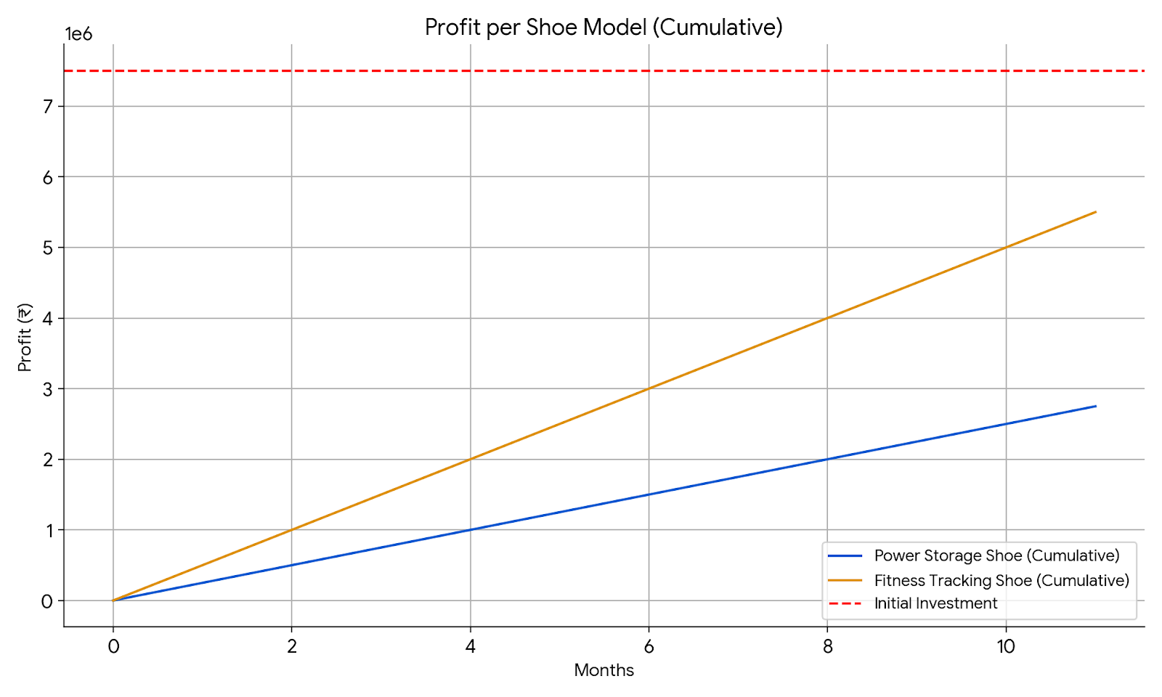
*Rough Estimates

Slide 19
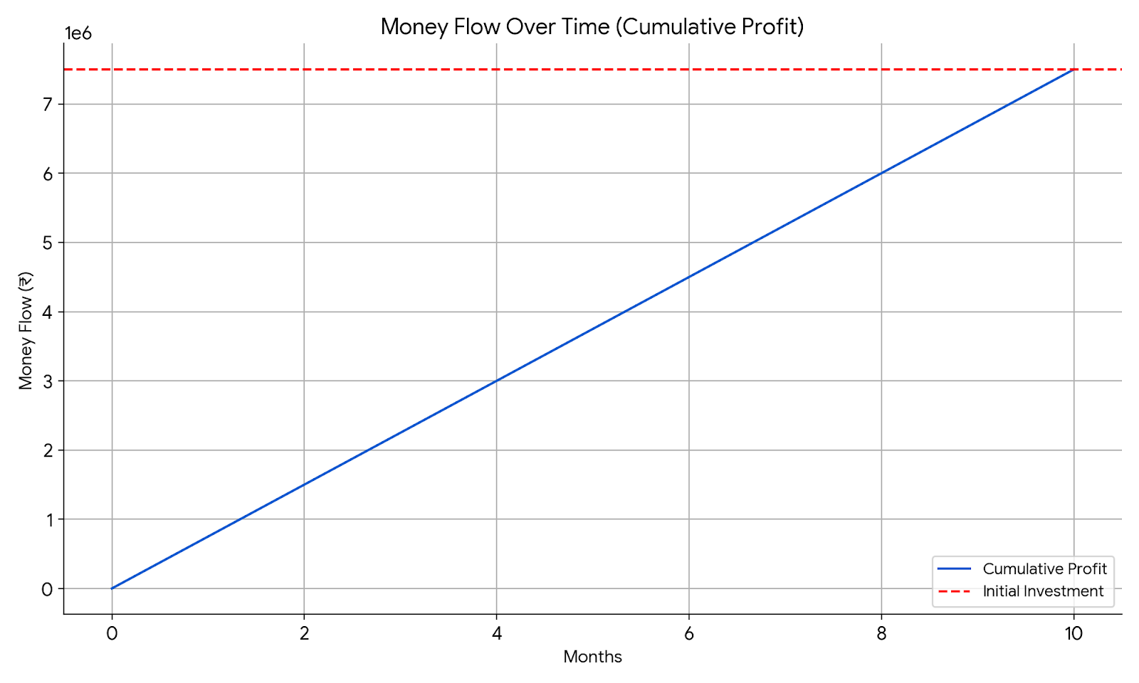
*Rough Estimates

Slide 20
Annual Revenue Projection:
After 10 months, aim to scale up production to 750 units/month for each model.
Increased Profit:
Expect monthly profits of ₹7,50,000 (Power Storage Shoe) and ₹15,00,000 (Fitness Tracking Shoe).
Annual Profit Projection:
Anticipate annual profits of ₹90,00,000 (Power Storage Shoe) and ₹1,80,00,000 (Fitness Tracking Shoe).
Total Annual Revenue:
Total Annual Revenue ≈ ₹3,45,00,000 (Including initial investment recovery).
Growth Strategy:
Plan to reinvest profits for further expansion and explore diversification opportunities.

Slide 21
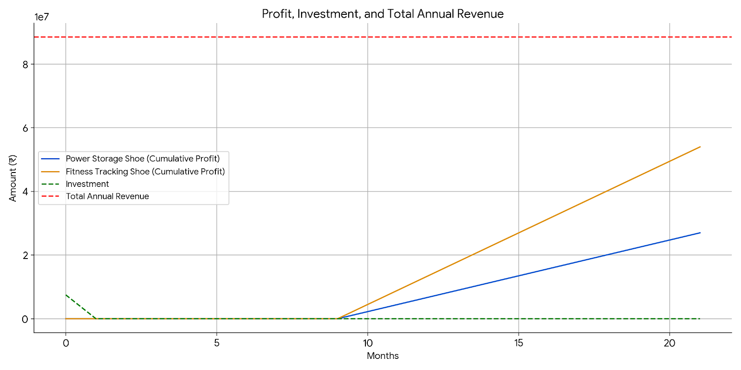
*Rough Estimates

Slide 22
Q & A

Slide 23
THANK YOU!

